Slide 1
Northwest Vista College Community Health Advisory Board Membership 2024-2025

Slide 2
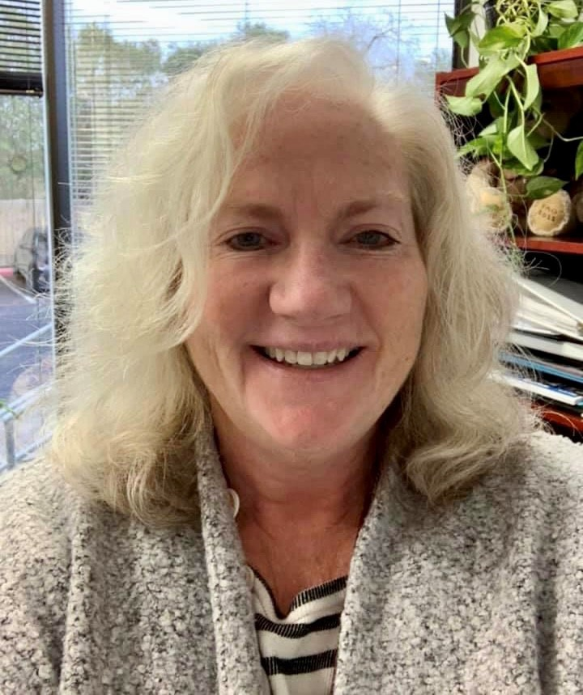
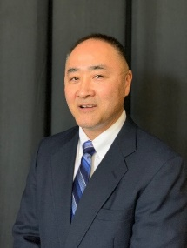
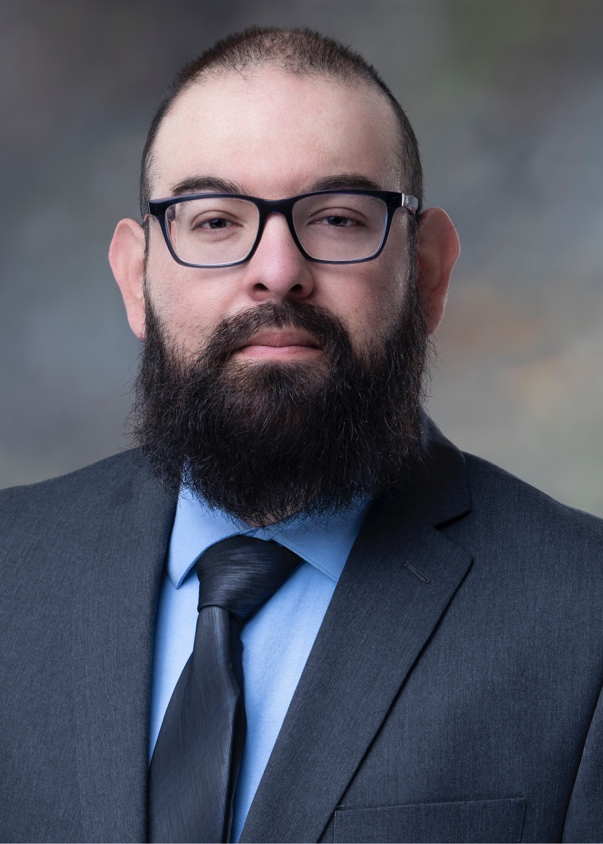
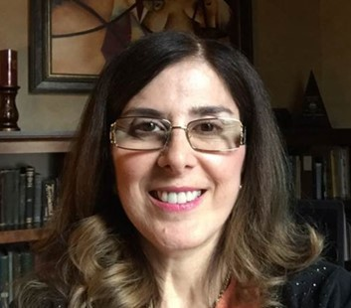
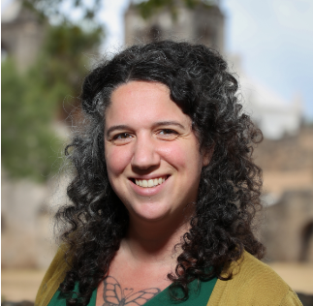
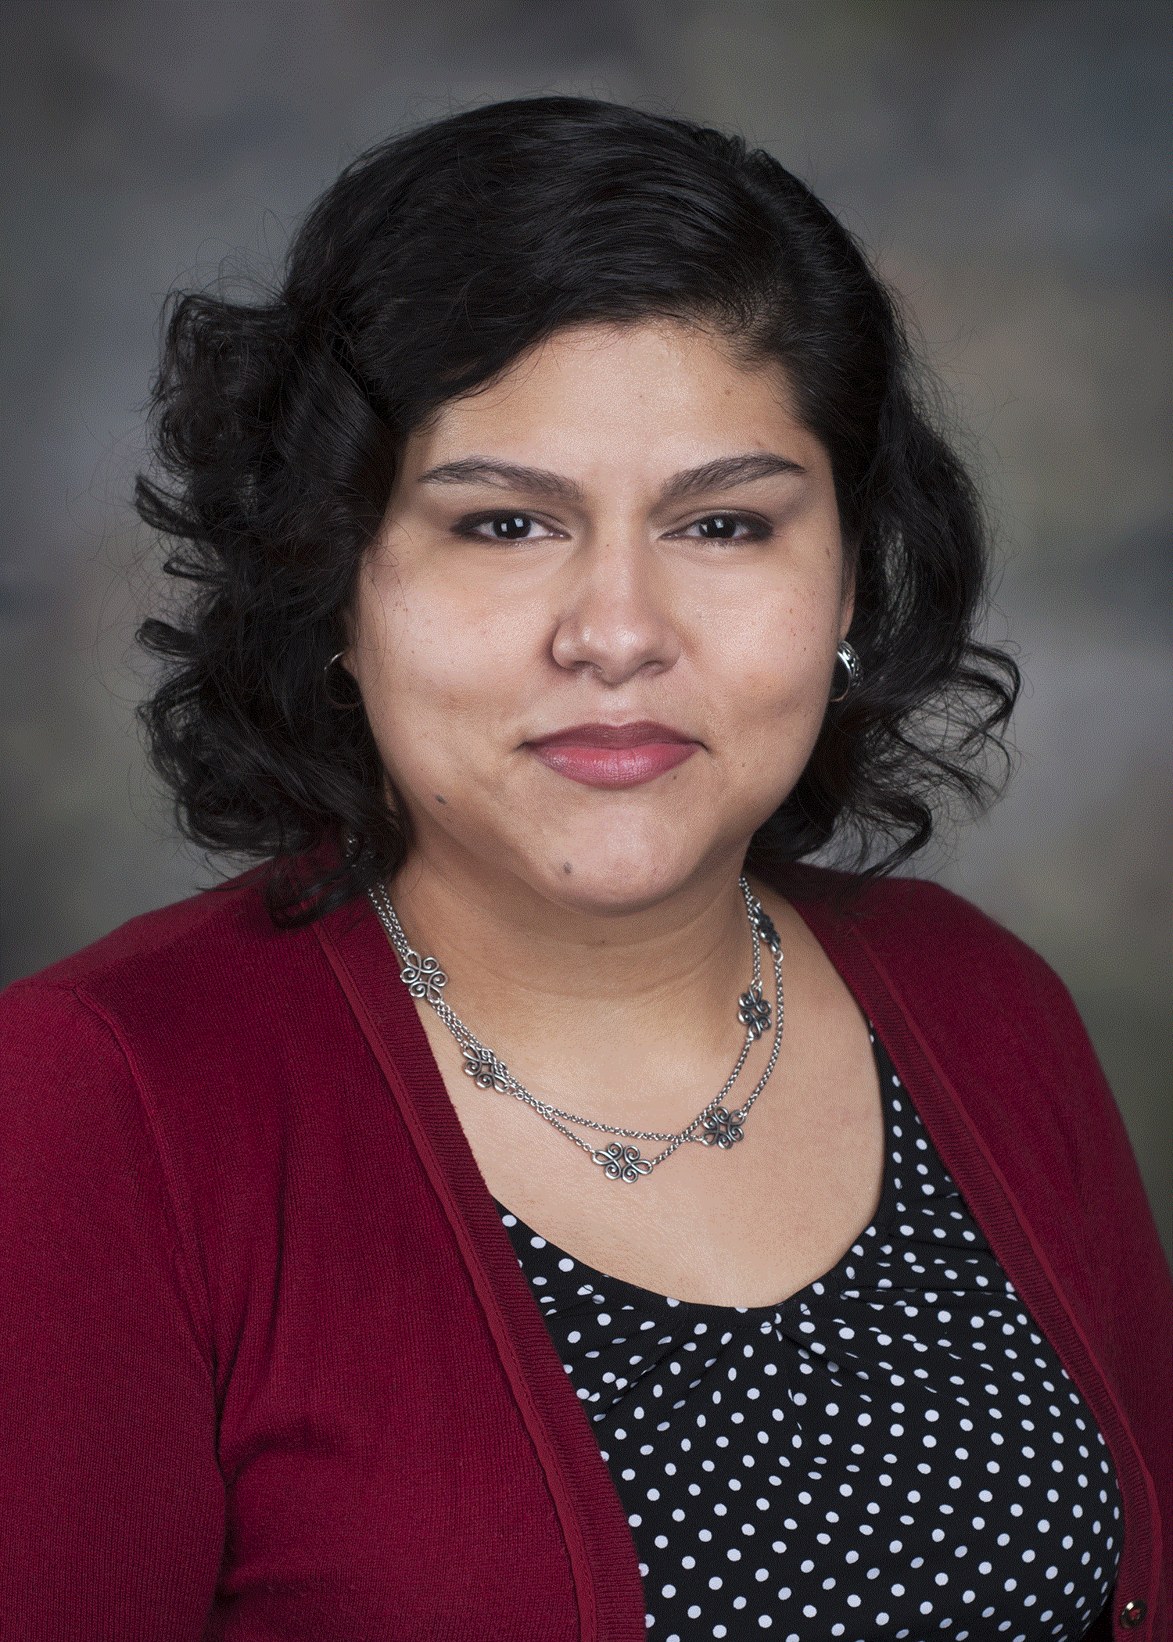
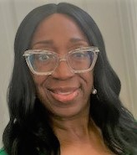
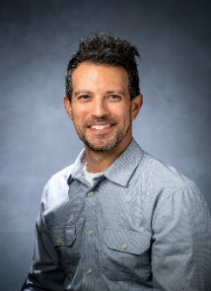
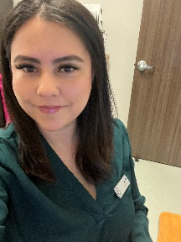
CHW ADVISORY BOARD MEMBERS 2024
Vicki Everett
Verne S. Futagawa
Santos Barrientes
Patricia Chalela
Anna Macnack
Inez I. Cruz
Toni Tercero
Gabe Aguilar
Elisabeth M. de la Rosa
Pegeen Seger
Carla Thomas

Slide 3
CHW Advisory Board Members
Planned Parenthood of
South Texas
Tonie Tercero
Patient Advocate
Victoria Everett
Program Coordinator/Quality Assurance
Alamo Colleges Economic
Workforce Development
Vern S. Futagawa
Account Executive for Skills Development Fund Grant
UT Health Institute for the
Integration of Medicine and
Science
Elisabeth M. de la Rosa
Operations Research Manager
UT Health, School
Of Public Health
Inez I Cruz
Director, Community Integration and Partnerships
UT Health San Antonio
Santos Barrientes
CHW
San Antonio Community
Pegeen Seger
UT Health, Retired

